Slide 1

Train Ticket Generation
Batch-88
“Team-02”
Presented By:
Manish Gupta
Adarsh Sharma
Monisha Narayan
Shraddha S Gowda
Sudhanshu Bhardwaj

Slide 2
Contents
Problem Statement
Flow Chart
Technologies & Languages Used
Results

Slide 3
Problem Statement
The project has to be developed for automating the manual system of ticket generation.
The main objective is to build a train ticket generation system which contains two panels passenger and admin where passenger can book ticket and print ticket. And management panel admin can add train, update train, delete train and find train.

Slide 4
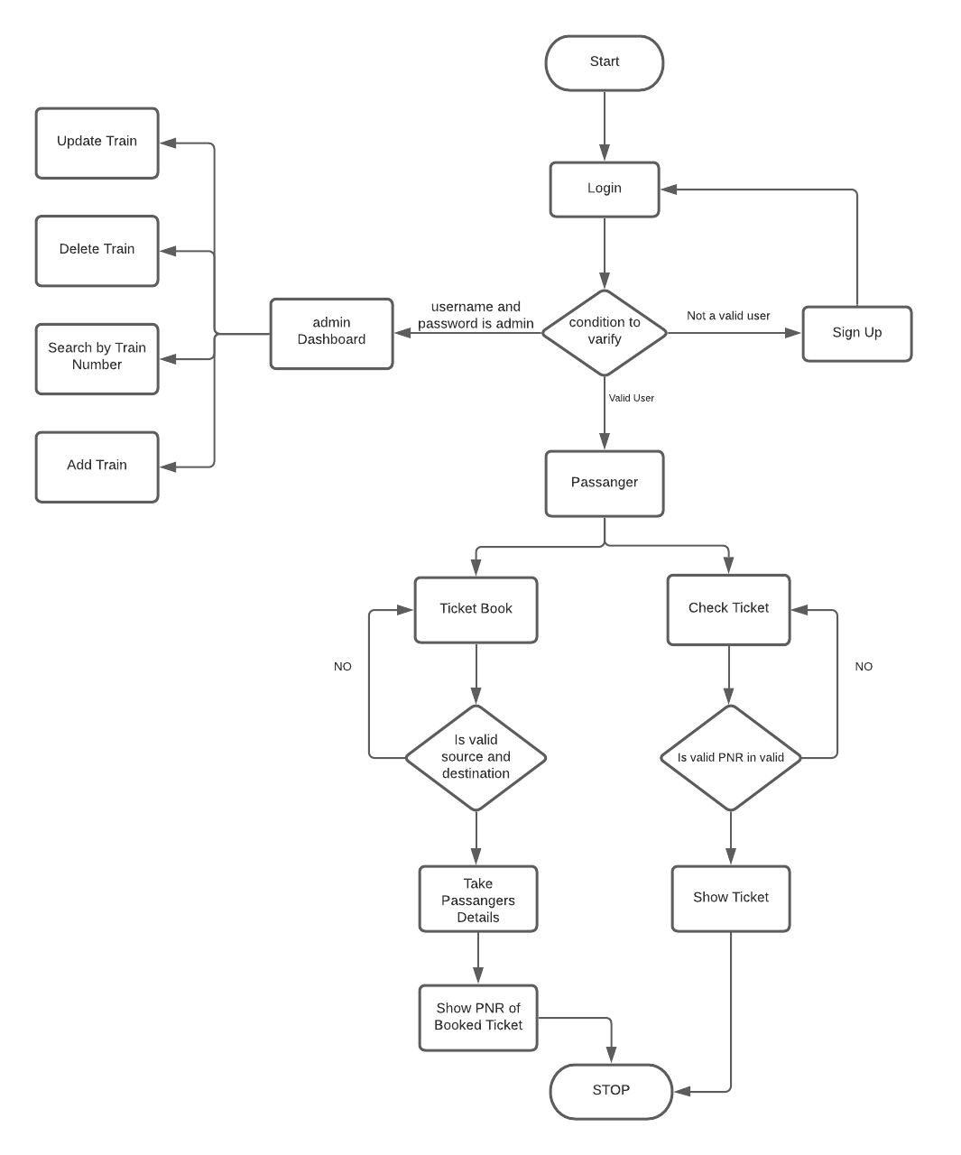
Flow Chart

Slide 5
Technologies & Languages Used
Spring boot framework
MySQL Database
Visual studio Editor
Java
Java Script
HTML
CSS

Slide 6
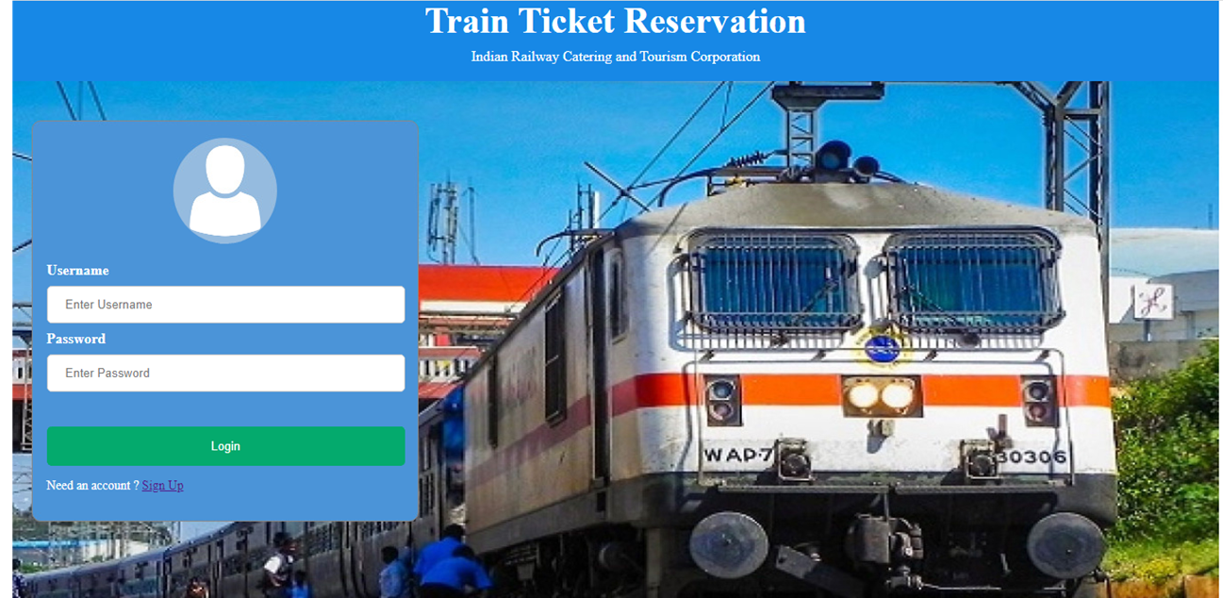
Results
Login Page

Slide 7
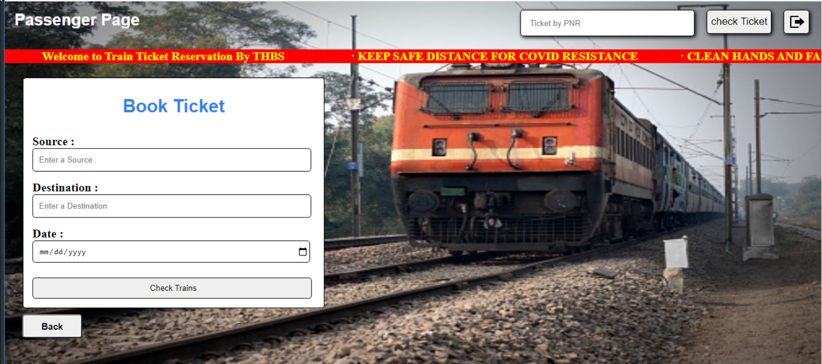
Passenger Page

Slide 8
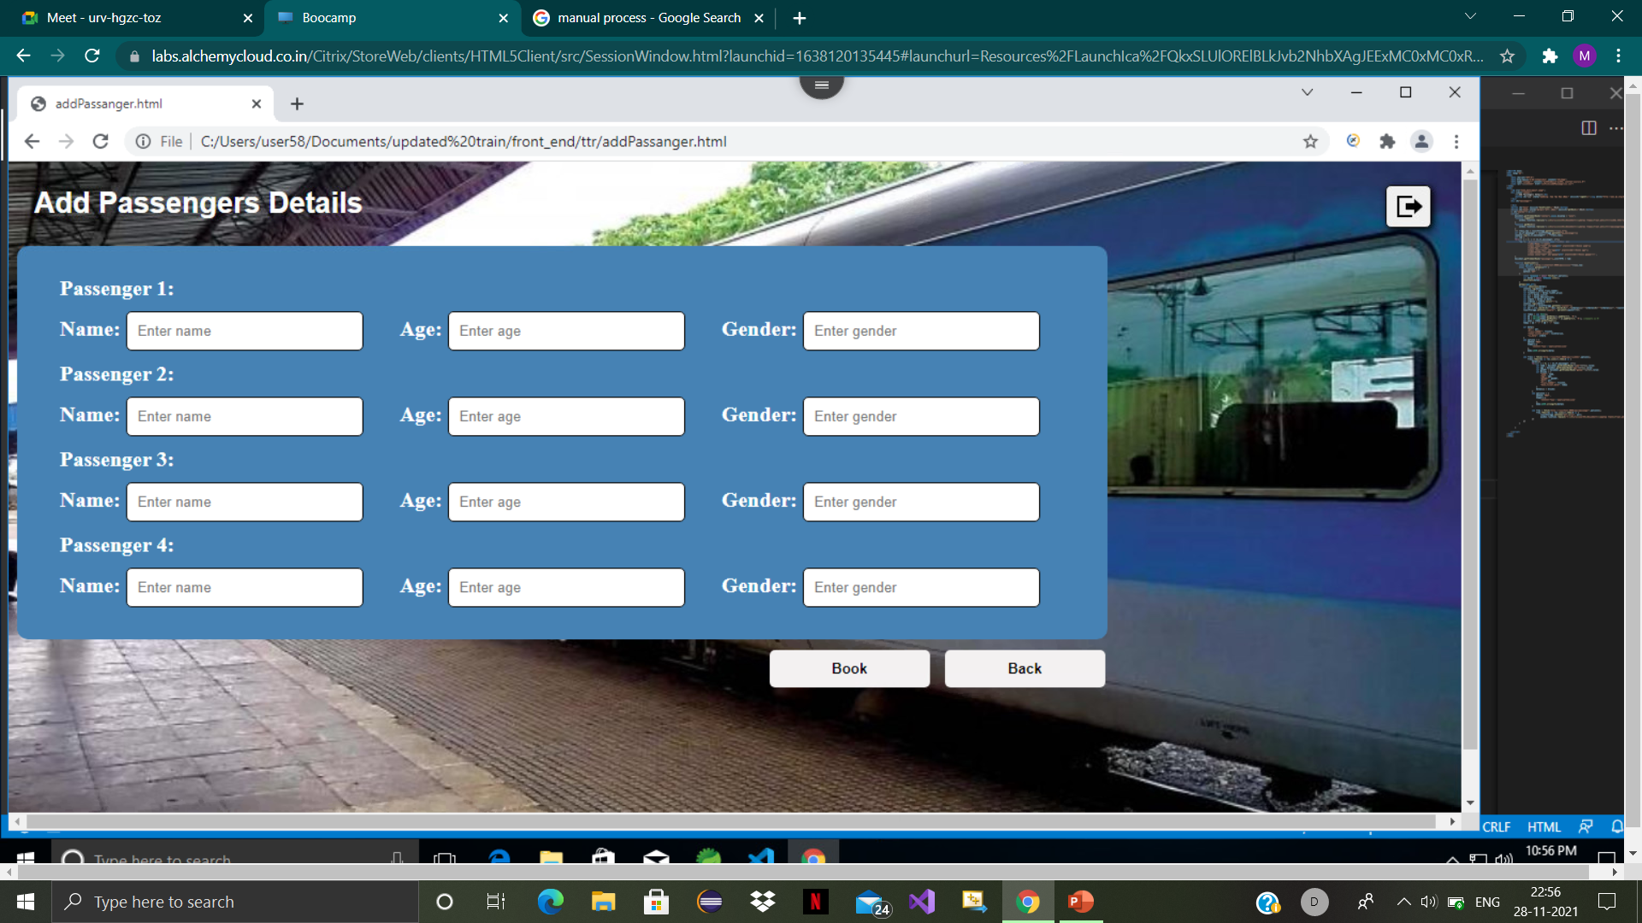
Add Passenger Page

Slide 9
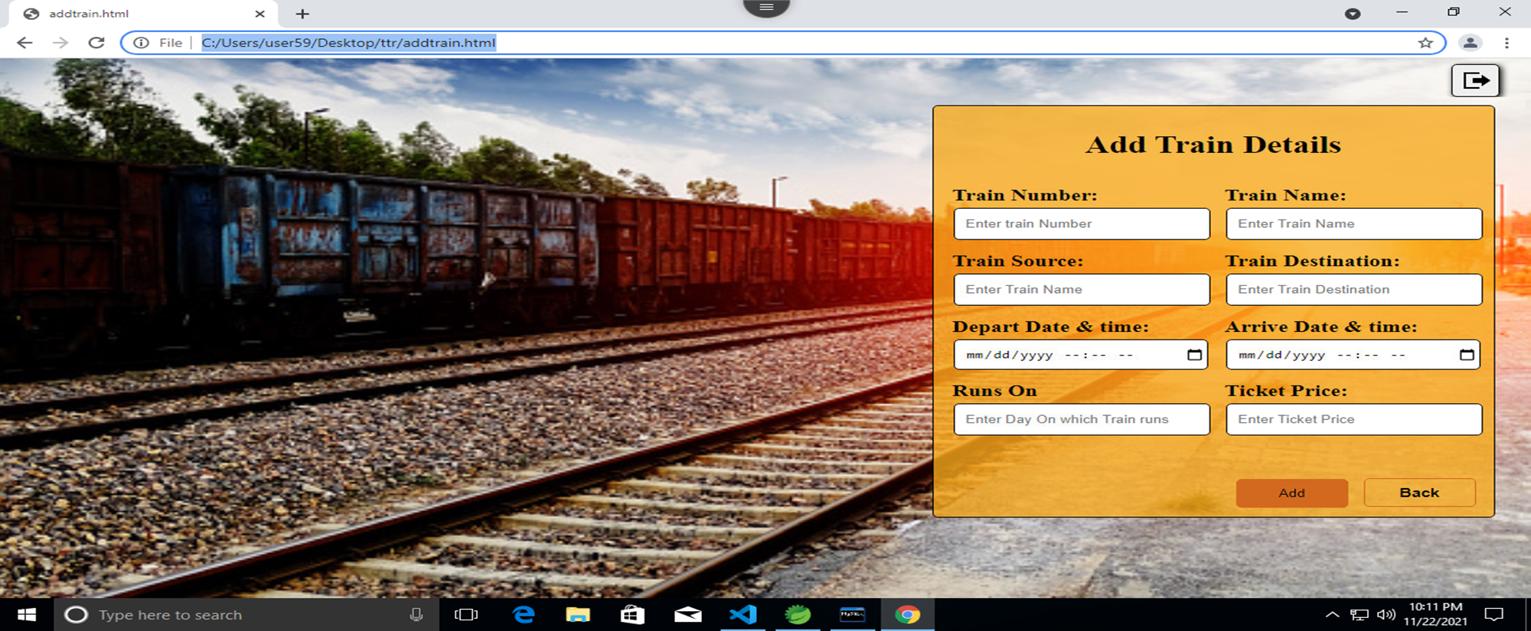
Add Train Page

Slide 10
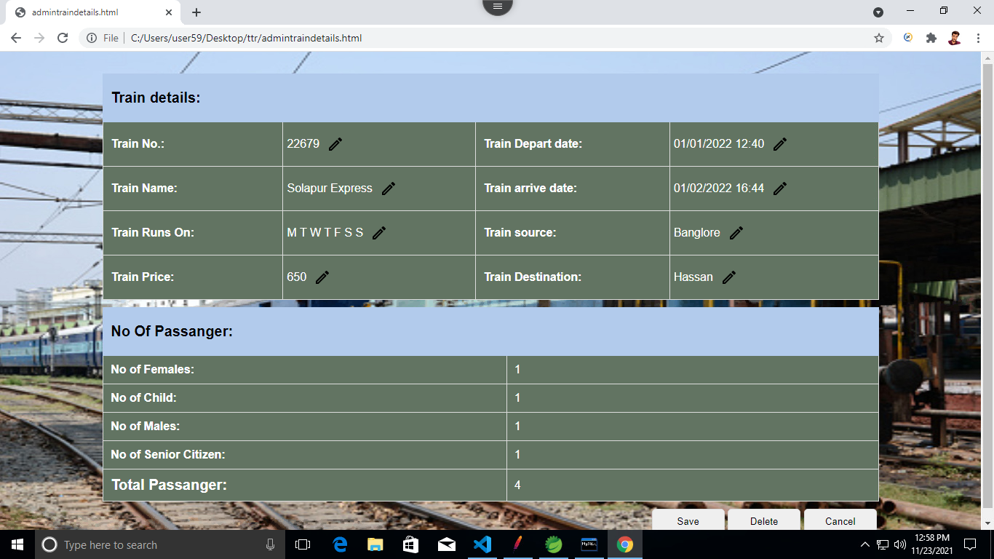
Train Details Page

Slide 11
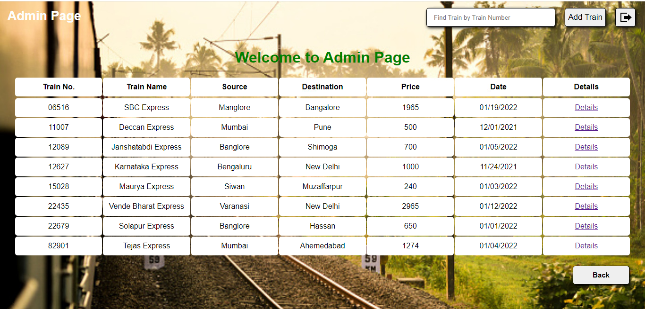
Admin Page

Slide 12
Thank You

